Slide 1
Employee Attrition Analysis & Prediction
A Data-Driven Approach Using HR Analytics
Presented by: Harish Rudraraju

Slide 2
Objective & Abstract
Objective: Identify reasons for employee attrition and predict resignations.
Used historical HR data (1,470 employees) with EDA and machine learning.
Developed a logistic regression model to forecast attrition.

Slide 3
Dataset Overview
1,470 employee records, 35 features.
Features: Demographics, Job Details, Compensation, Satisfaction, etc.
Target: Attrition (Yes/No), cleaned categorical & constant features.

Slide 4
Key EDA Findings
R&D: Highest numeric attrition
Sales: Highest attrition rate
HR: Most stable department with low attrition

Slide 5
Age & Job Role Analysis
Age 25–35: Highest attrition risk
Post-40: More stability
Highest attrition roles: Lab Technicians, Sales Executives
Lowest: Managers, Directors

Slide 6
Correlation Insights
Low income => higher attrition
Job Satisfaction (r = -0.103): higher satisfaction = lower attrition
Work-Life Balance (r = -0.064): slight negative correlation
Distance from Home: weak positive correlation

Slide 7
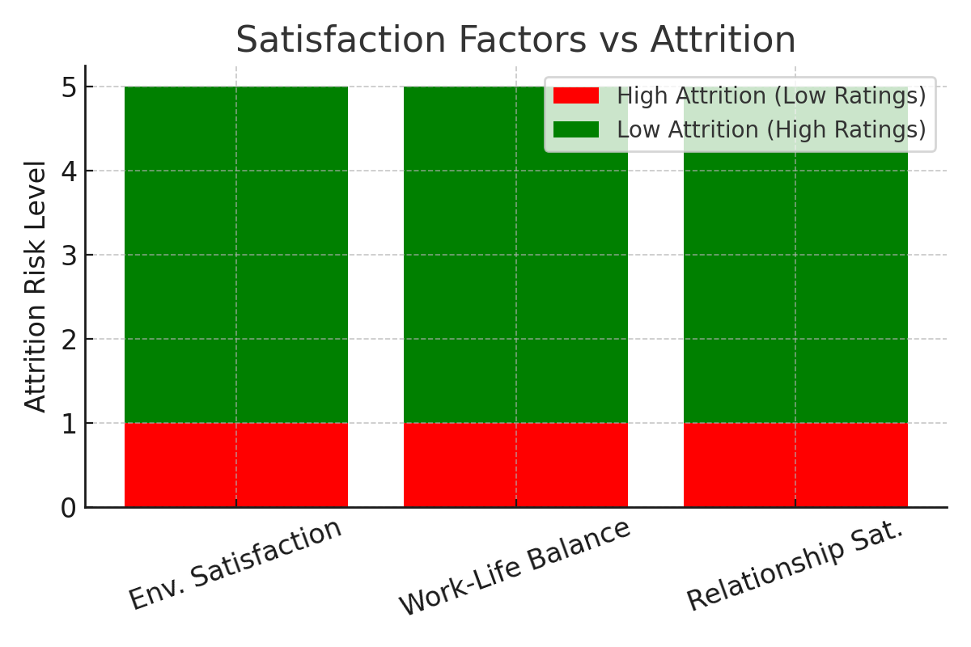

Slide 8
Machine Learning Model
Model: Logistic Regression (Supervised Learning)
Steps: Data cleaning, feature selection, scaling
Train-test split: 70:30, accuracy before tuning: ~69%
Used GridSearchCV for hyperparameter tuning

Slide 9
Model Results
Post-tuning accuracy: ~70%
Better identification of at-risk employees (Attrition = Yes)
Balanced predictions with improved sensitivity
Useful for HR intervention planning

Slide 10
Final Conclusion
Attrition driven by multiple factors: income, satisfaction, age, etc.
Focus areas: Competitive pay, work-life balance, job engagement
Model helps predict risk and enables proactive HR actions
Supports building a loyal, stable workforce

Slide 11
Visual Analysis of Attrition Factors
Based on Power BI Interpretations

Slide 12
Department-wise Attrition
R&D is most affected numerically, not by percentage.
Sales has a relatively higher attrition rate.
Human Resources shows minimal attrition, indicating stability.

Slide 13
Income vs Attrition
Employees who left generally had lower monthly income.
There is a strong correlation between low income and high attrition.

Slide 14
Age-wise Attrition
The 25–35 age group represents the highest retention risk.
Attrition declines with age; older employees are more stable.

Slide 15
Job Satisfaction & Attrition
Employees with low job satisfaction (levels 1 & 2) are more likely to leave.
Attrition significantly decreases with increasing satisfaction.

Slide 16
Environment Satisfaction
Negative correlation observed between environment satisfaction and attrition.
Better environment = Lower attrition.

Slide 17
Work-Life Balance
Better work-life balance is linked to lower attrition.
Levels 3 & 4 show stronger retention; levels 1 & 2 indicate risk.

Slide 18
Relationship Satisfaction
Attrition decreases as relationship satisfaction improves.
Positive workplace relationships contribute to employee retention.

Slide 19
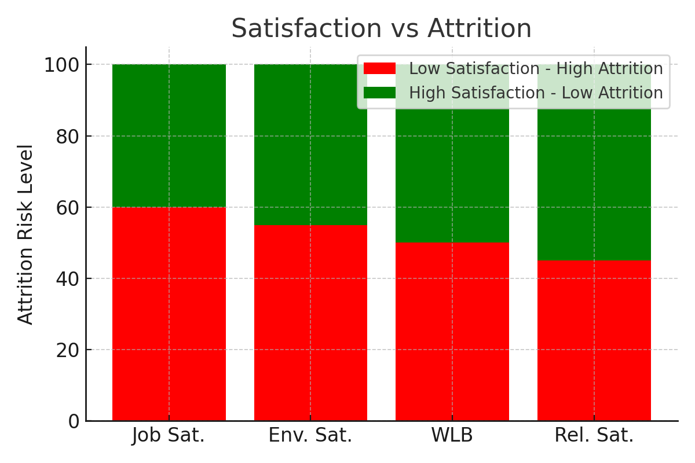

Slide 20
Conclusion
Attrition is multi-factorial: job satisfaction, income, age, and work-life balance matter.
Focus areas to reduce attrition:
- Enhance job satisfaction and engagement
- Offer competitive compensation
- Foster a positive work environment
- Improve work-life balance and relationships

